Slide 1

Testing and Verification (CSC7056/CSC3056)
Aidan McGowan
The Test Specification Process

Slide 2



The Test Specification Process
Analyse, Design and Implement

Slide 3

Test Analysis
Test analysis is the process of looking at something that can be used to derive test information.
This basis for the tests is called the test basis.

Slide 4
Test Basis
Test basis : All documents from which the requirements of a component or system can be inferred. The documentation on which the test cases are based.
If a document can be amended only by way of formal amendment procedure, then the test basis is called a frozen test basis.
  requirements
  design specifications
  product risk analysis
  architecture and interfaces
May also include experienced user’s knowledge of the system.

Slide 5
Test Condition
From testing perspective we look at the test basis in order to see what could be tested.
These are the test conditions
Test basis
identify what you need to test
Test condition

Slide 6
Test Condition
A test condition is simply something that we could test.
Test Condition: An item or event of a component or system that could be verified by one or more test cases, e.g. a function, transaction, feature, quality attribute, or structural element.

Slide 7
Traceability
Establishing traceability from test conditions to requirements
  Enables effectiveness impact analysis when requirements change
  Enables determination of requirements coverage for a set of tests.

Slide 8
Test possibilities
While identifying the test conditions we want to identify as many conditions as we can and then we select about which one to take forward and combine into test cases. We could call them test possibilities.
  Testing everything is an impractical goal
  Select a subset of all possible tests
  Yet it has to have a high probability of finding most of the defects in a system
  Need some intelligent thought process to guide our selection called test design techniques.

Slide 9
Choosing and prioritising
The test conditions that are chosen will depend on the test strategy or detailed test approach. For example, they might be based on risk, models of the system, etc.
Once the list of test conditions are identified, then prioritise.
Test conditions can be identified for test data as well as for test inputs and test outcomes, for example, different types of record, different sizes of records or fields in a record.
Test conditions are documented in the IEEE 829 document called a Test Design Specification (adapted versions are used widely within the Test Industry)

Slide 10
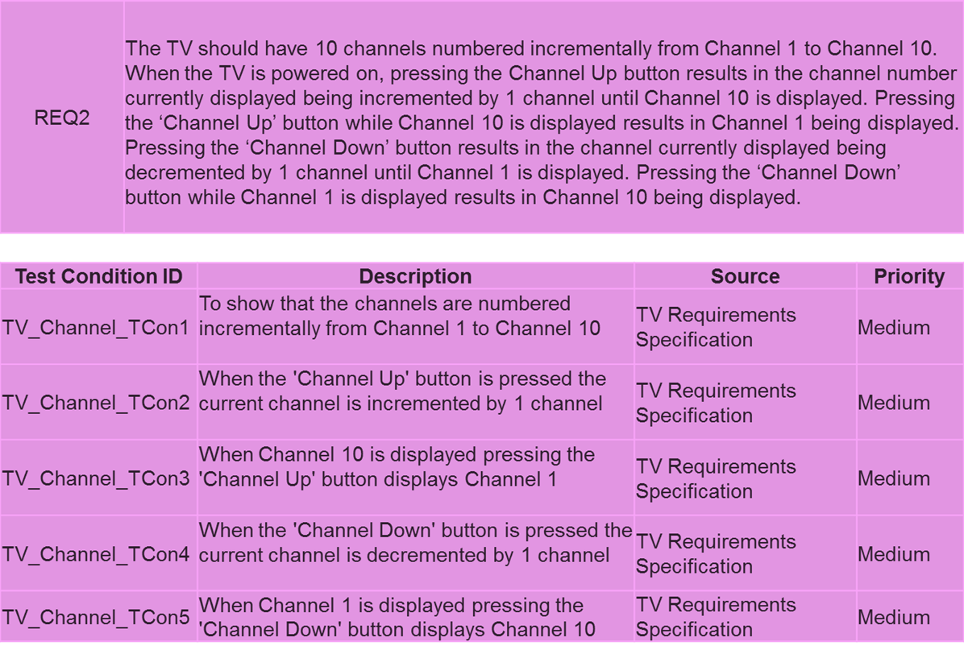
Test Conditions – Case Study (Test Design Specification format)
Test Specification Process – Test Design
© SQS Group Limited | Test Specification Process |

Slide 11



Design
The act of creating and writing test suites for testing software.
Test analysis and identifying test conditions gives us a generic idea for testing which covers quite a large range of possibilities. But when we come to make a test case we need to be very specific
Analyse
Test conditions
Now decide
How you’re going to prove them
Design
These are your …
Test cases

Slide 12



Implementation
The document that describes the steps to be taken in running a set of tests and specifies the executable order of the tests is called a test procedure in IEEE 829, and is also known as a test script.
When the Test Procedure Specification is prepared and then implemented and is called Test implementation.
Design
Test cases
Document the steps involved in a test case
Implementation
Test procedure

Slide 13

Running the Test - Execution
The combination of the data in the Test Cases (test data such as inputs, and expected outputs for each test case) combined with the Test Procedure Specification (the steps or instructions) …

Slide 14
The Big Picture

Slide 15







Read the test basis
Test Basis – Document from which we draw test cases e.g. requirements “Verify the user can login using a valid username and password”
This enables you to …
Identify what you need to test
Analysis
These are your ….
Test conditions
Test Conditions – Test Design Specification
“What” we want to test.
With a valid user ID and password we can login
Without a valid user ID and password we cannot login
Now decide
How you’re going to prove them
Design
These are your …
Test cases– Test Case Specification
“How” are we going to prove the test condition.
Username Password Expected result
Valid – Aidan Valid – Password Login
Valid – Aidan InValid – xxx Fail to Login
InValid – Claire Valid – Password Fail to Login
InValid – Claire InValid – xxx Fail to Login
Test cases
Then drill down to the detail…
Document the steps involved in a test case
Recorded in the test procedure
Implementation
Test Procedure – Test Procedure Specification
The script containing the test steps
Enter User ID
Enter password
Press OK
Test procedure
The Test Specification Process

